Slide 2
Minor Project - 2 Vision based Mid-Air Writing and Recognition of Characters BTech CSE-OSOS(2018-2022)
Submitted By:
Giriraj Molasaria- 19 Prakhar Buliya- 36
Kunal Bharadwaj - 27 Ritwik Jha - 47
Mentored By: Dr. Abhishek Pandey Assistant Prof. Dept of Cybernetics

Slide 3
Introduction
Air-writing refers to writing of characters or words in a free space by hand or finger movements. It involves sequence of hand or finger movements. Air writing differs from the conventional handwriting, as it involves sequential discrete stroke.
Devanagari is an Indic script and forms a basis for over 100 languages including Hindi, Marathi, Sanskrit. It consists of 47 primary alphabets, 14 vowels, and 33 consonants, and 10 digits. There is no capitalization of alphabets, unlike Latin languages.
Convolutional Neural Network (CNN) trained on EMNIST-Letter Dataset to recognize the characters drawn with the finger.

Slide 4
Problem Statement
There are existing systems out there in the world which are developed to recognize characters of the worldwide accepted language, i.e., English. To create a machine learning application in python for recognizing characters written in the air with hand using image segmentation, contouring and convolutional neural network(CNN). It uses OpenCV and Pytorch libraries.

Slide 5

Objectives(Achieved)
To create an system so powerful that it recognizes the handwriting of a user in mid-air .
To Predict the character drawn by the user.
To help the people in making the learning more efficient , better and to help them concentrate on the learning part.

Slide 6
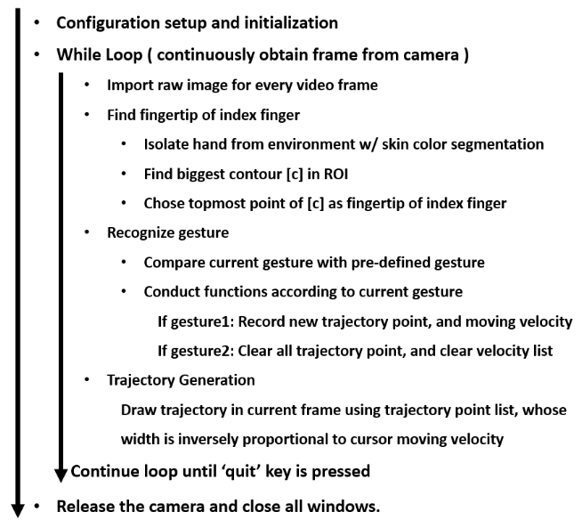
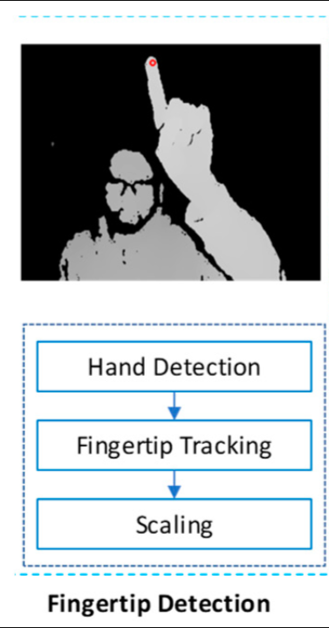
Methodology

Slide 7
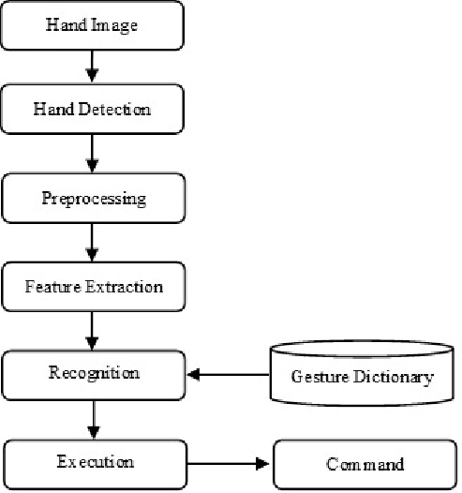
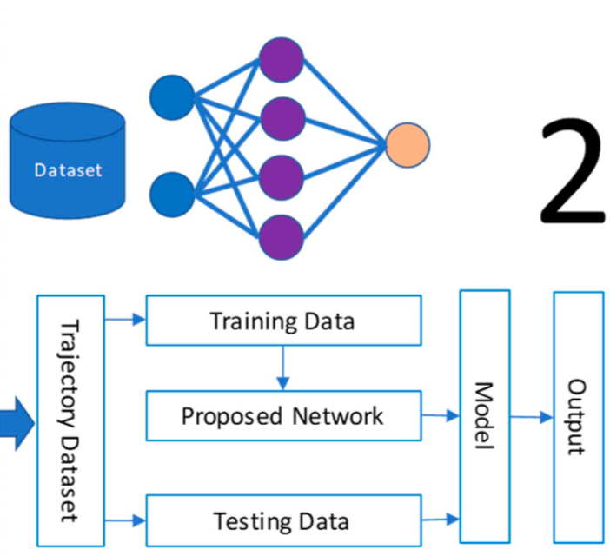
Flowchart

Slide 8
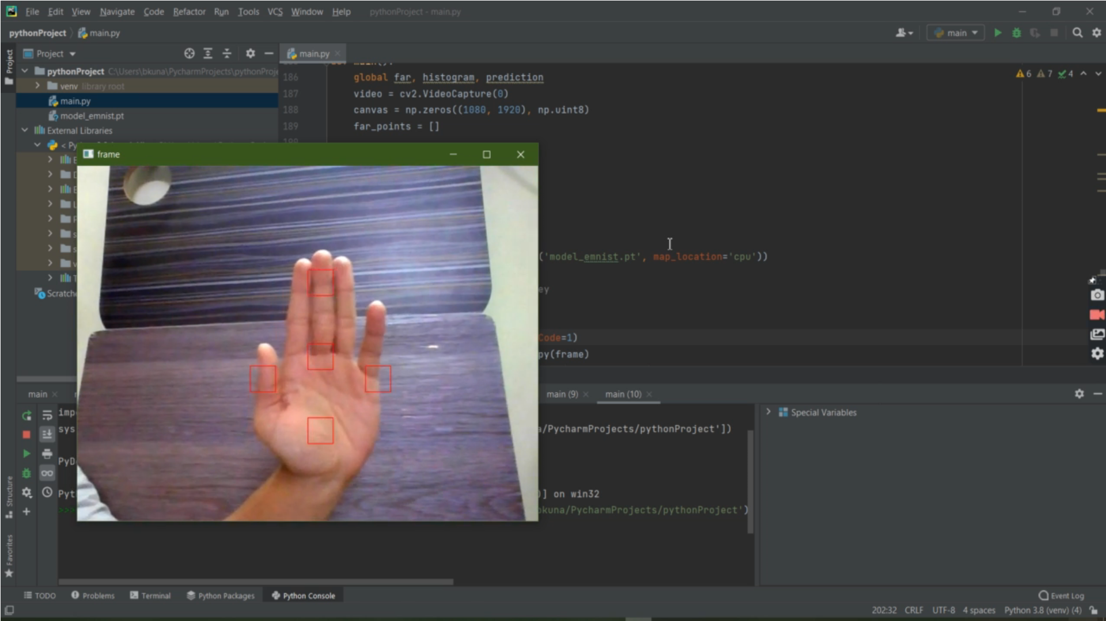
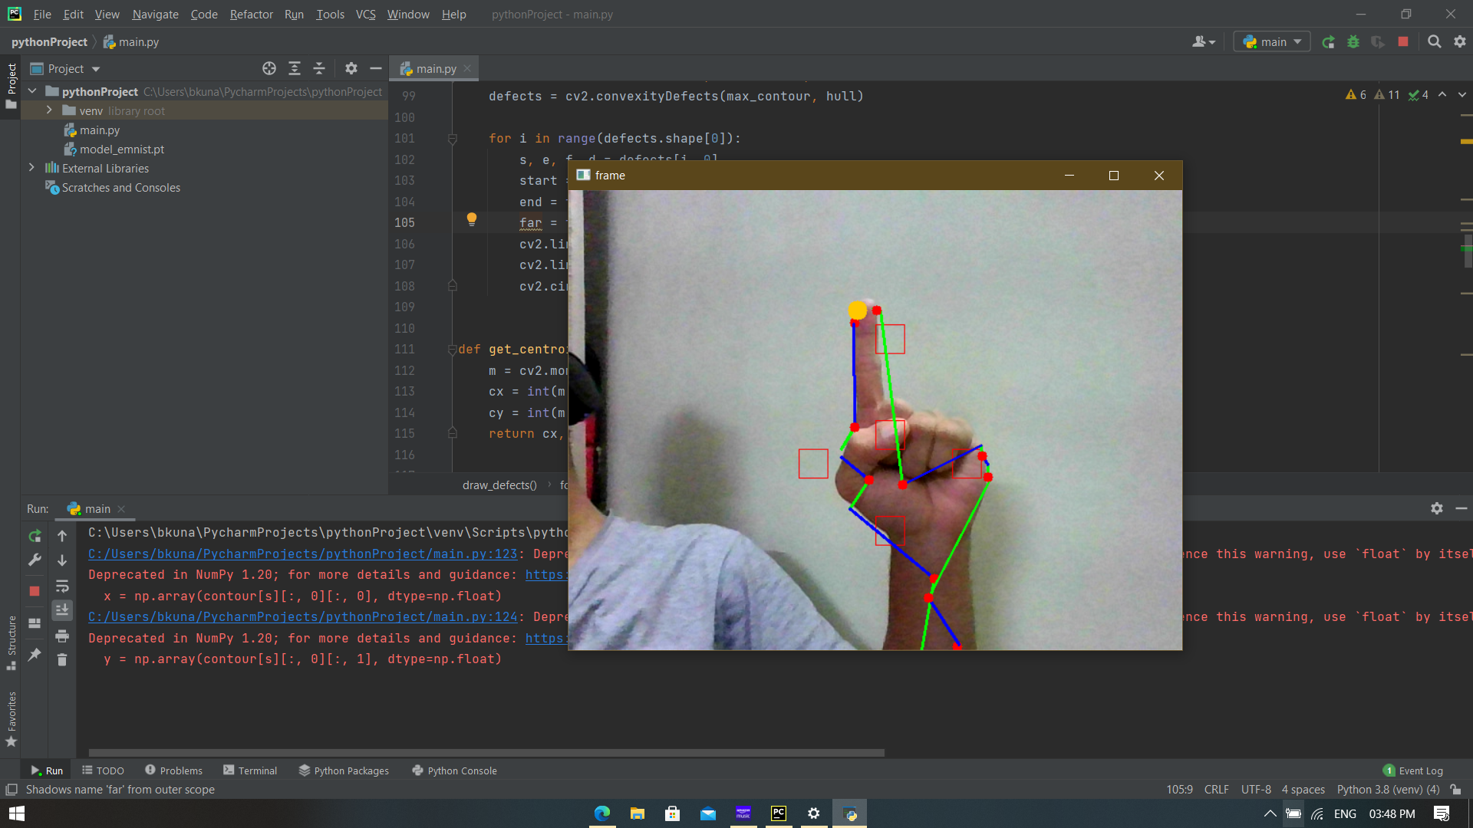
Output Screen
LINKS:-
DRIVE:OUTPUTVEDIO - Google Drive
GITHUB:BhardwajKunal23/Mid-air-CharacterRecongnition (github.com)

Slide 9
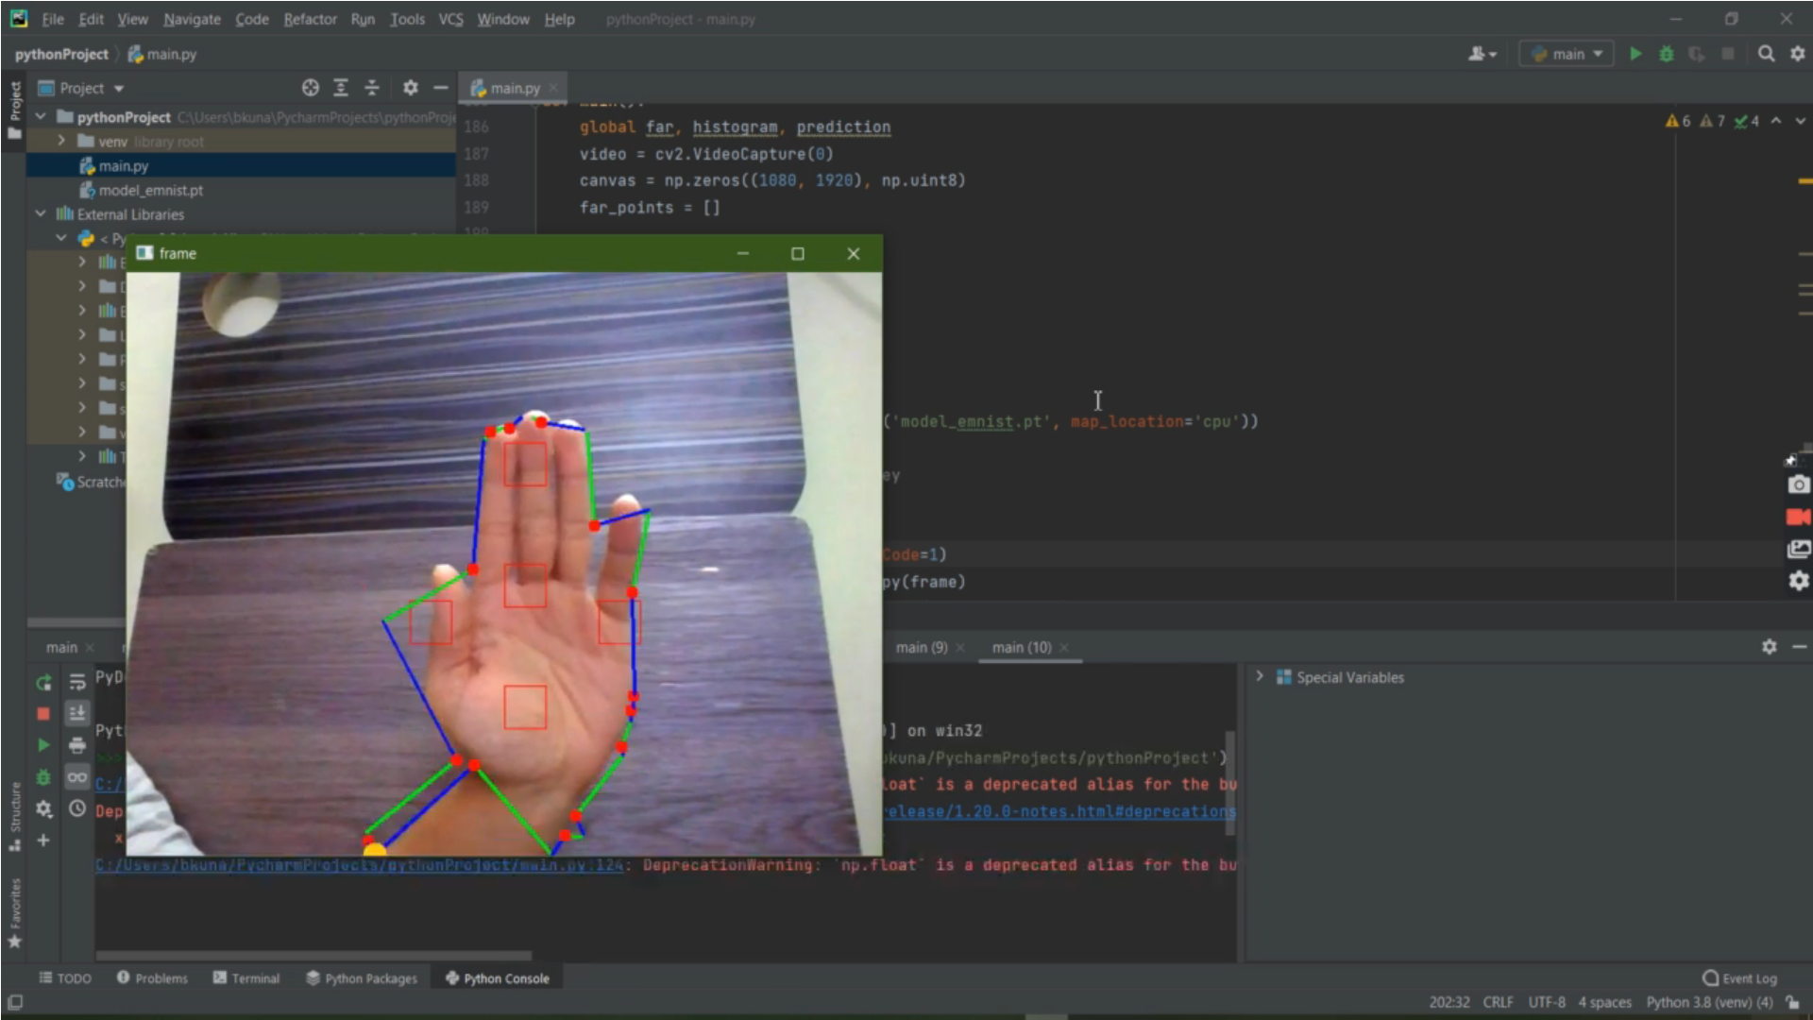
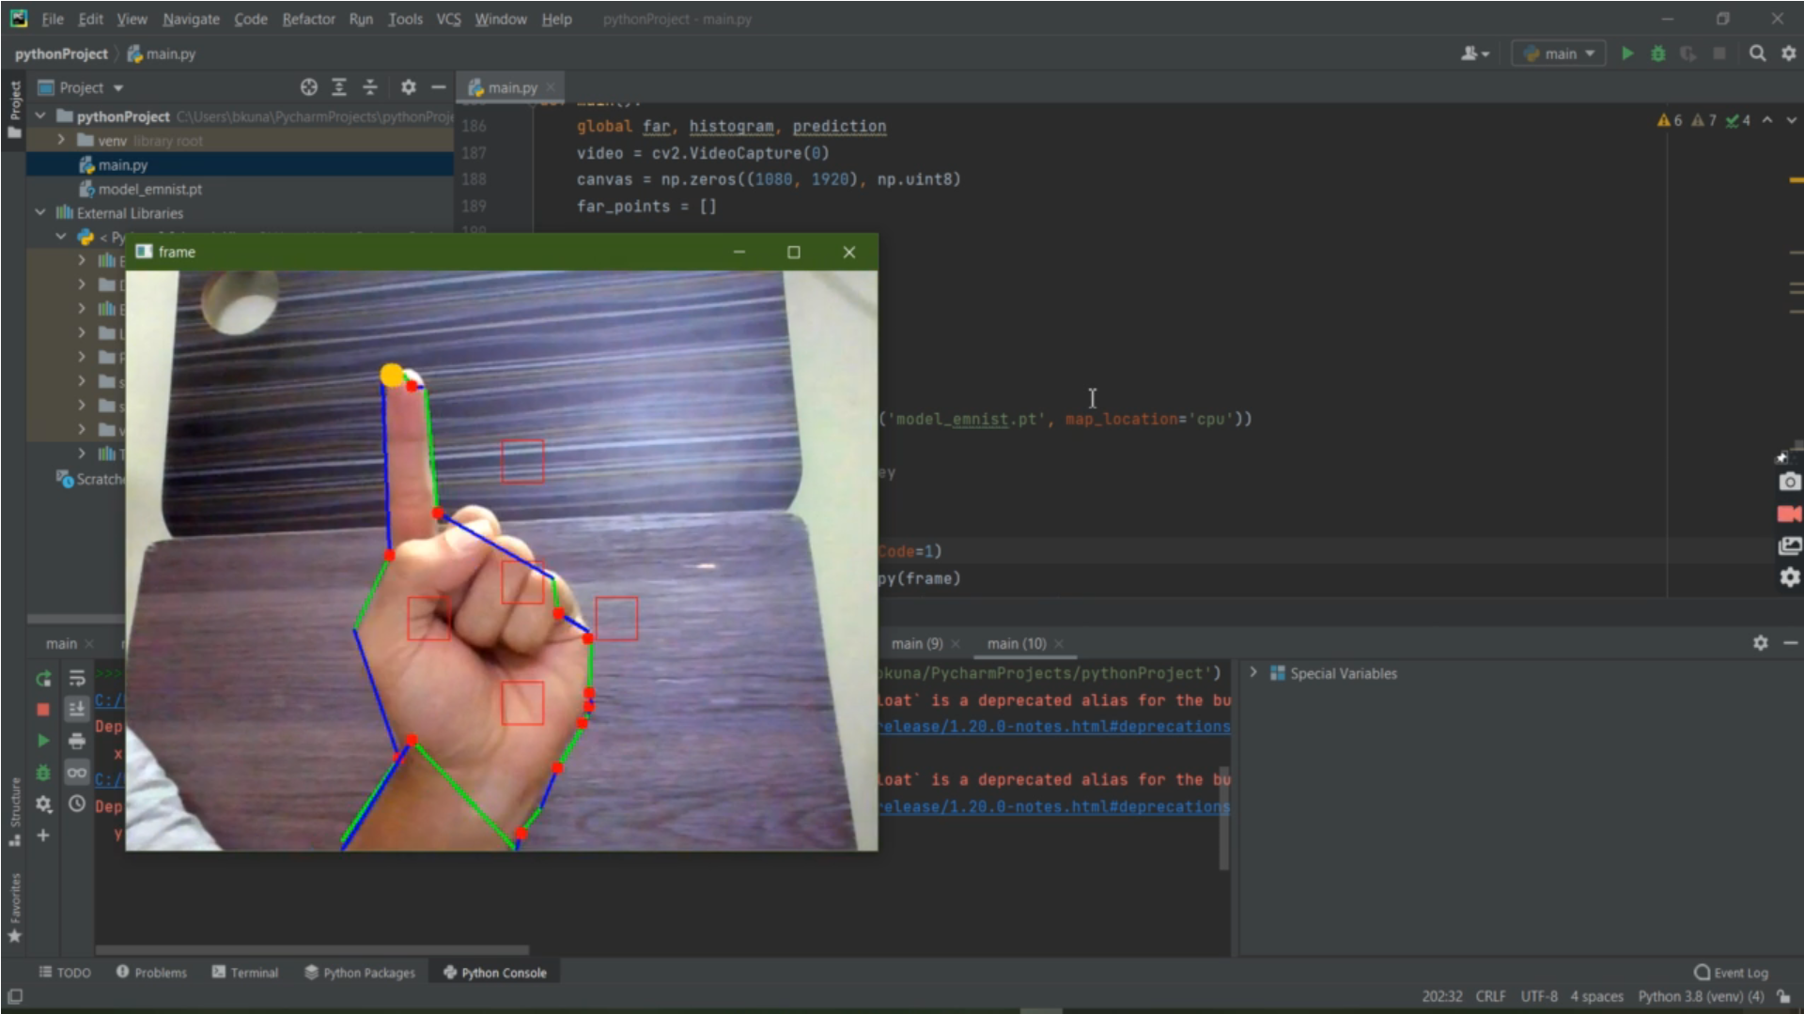
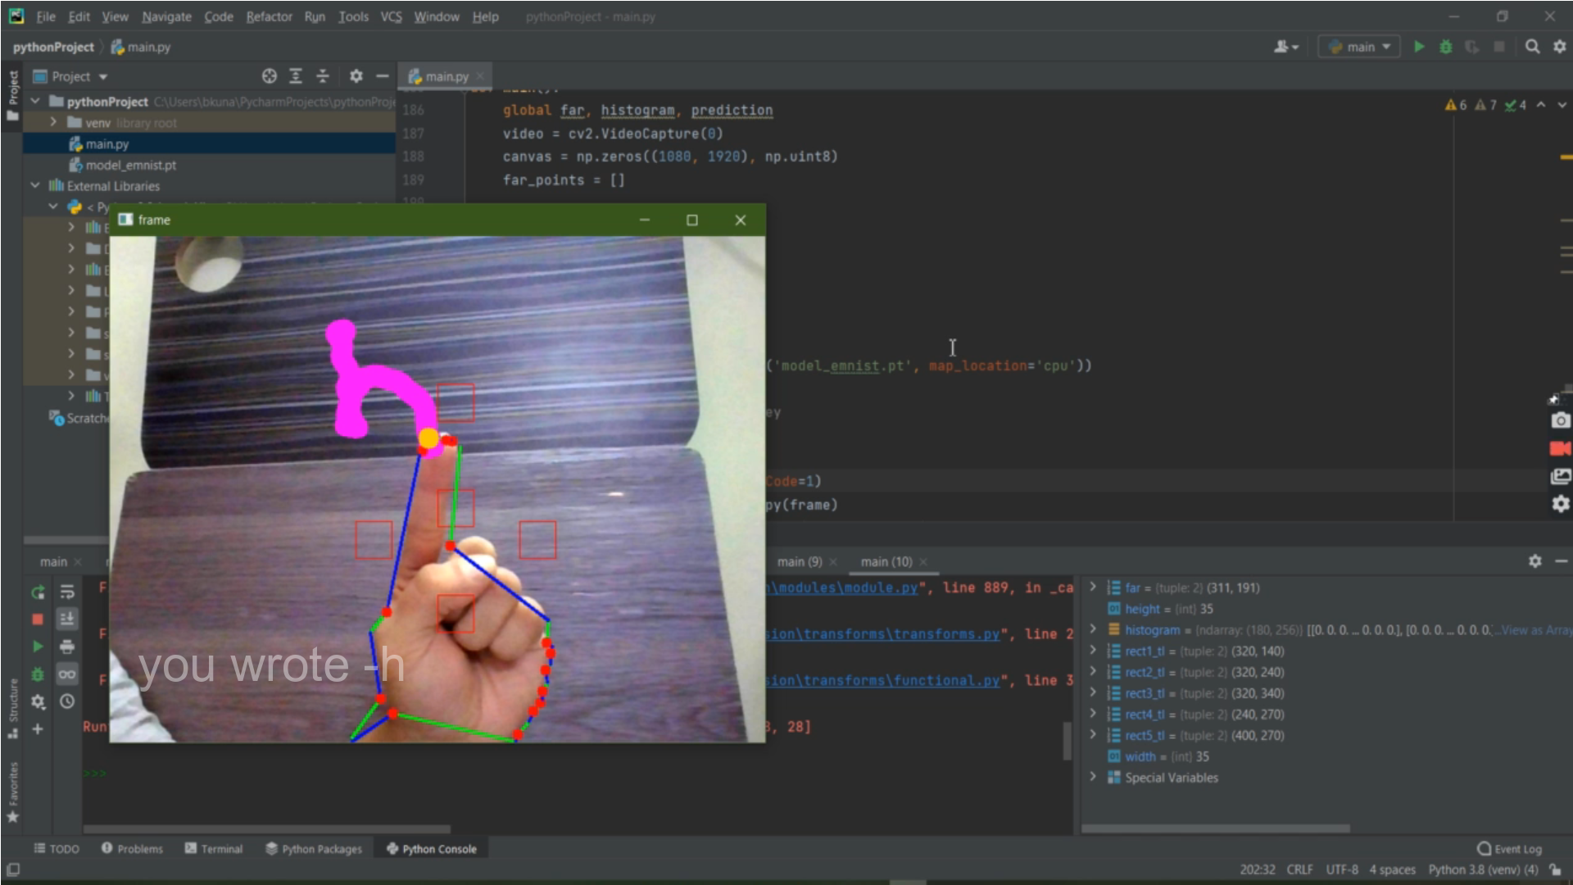

Slide 10
Conclusion(Result Analysis)
The character drawn in the frame provided is being recognized by the camera very efficiently that the exact frame points of the same is being displayed on the screen without leaving any kind of ambiguity.
Skin tone of hand is extracted so that it works in different lighting conditions using Histogram and hand is pulled out from the image using Back-Projection.

